Slide 1
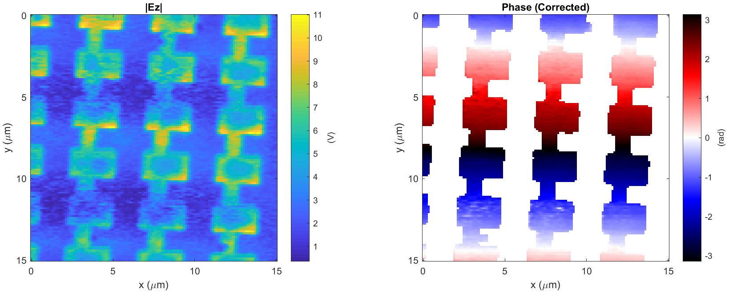
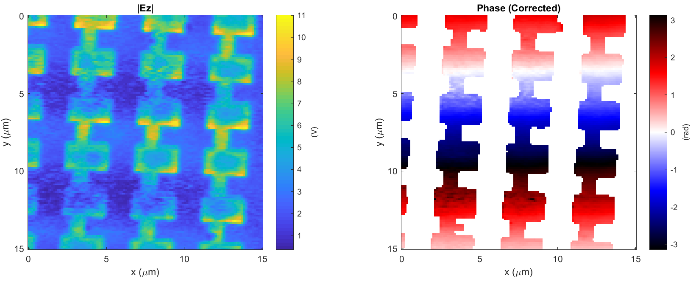
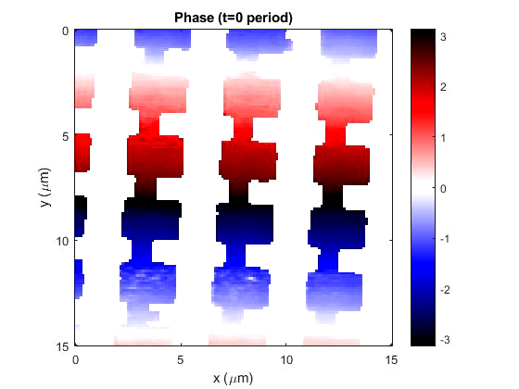
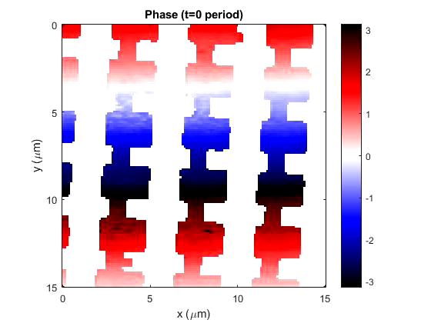
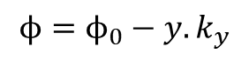
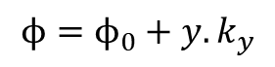
Phase subtraction
Phase addition
$${ϕ=ϕ}_{0}−y.k_{y}$$
$${ϕ=ϕ}_{0}+y.k_{y}$$
Data: 2018-04-17_leaky_E_4_V_RHCP_X_3

Slide 2
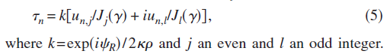
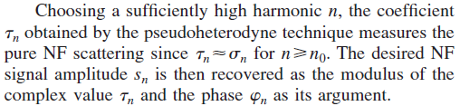
Implementation of phase correction
From Ocelic et al. “Pseudoheterodyne detection for background-free near field spectroscopy”, let un,m the measured signal from the n-th harmonic and the m-th sideband, then
So the field amplitude |E_{z}|=modulus( ) and the phase φ_{o}=atan(Im/Re)
Phase correction: φ=φ_{o} ± ysinθ(2π)/λ

